Slide 1
Academic Year Safety Updates
Faculty Senate – Dec. 4, 2018

Slide 2
What’s new @ VCU
Siren System Upgrade & Alerting Technology
Upgraded to ALERTUS (Cabell, Sports Med, VCUPD HQ, College of Health Professionals, McGlothlin & GRC (pending))
Self tests every day
No more monthly siren tests
Full test twice a year (desktop alerts, ALERTUS beacons, email, SMS, LiveSafe and Social Media)
LiveSafe
Upgrading to card based screen (better user interface)
Street harassment button
Desktop panic buttons: testing

Slide 3
Keeping campuses safe
Crosswalk / intersection safety campaign
Light timing
Messaging
Pedestrians
Bicyclists
Scooters
Drivers
Sidewalk Graphics
City repainting of crosswalks
Vision Zero partnership with the City of Richmond
Vehicle vs. Bike 0% (7 AY 17/18 & 7 AY 18/19)
Vehicle vs. Pedestrian -27% (22 AY 17/18 & 16 AY 18/19)

Slide 4
Keeping campuses safe
Classroom Safety
Push-button door locks
Retro fitting classrooms

Slide 5
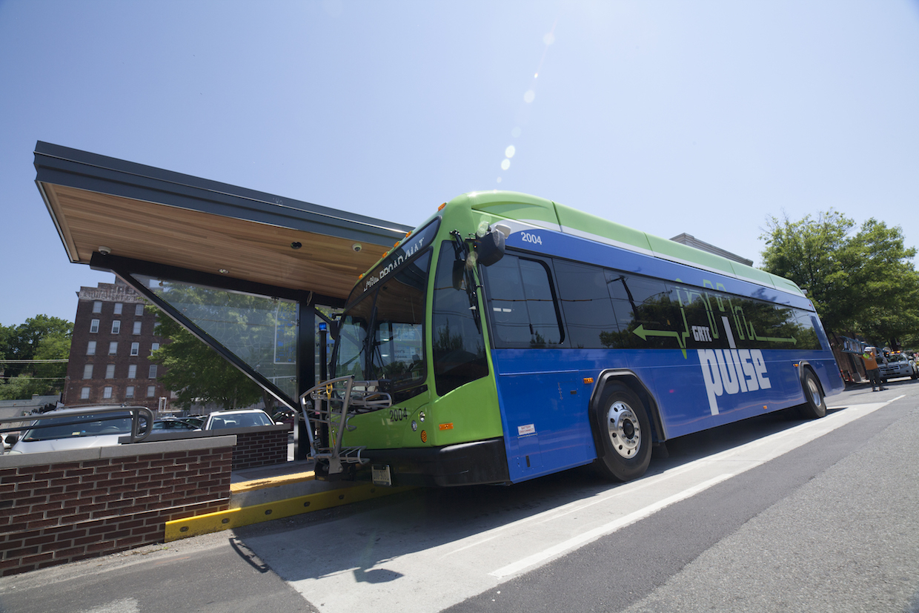
Parking & Transportation
GRTC / Pulse
Police have had a focus on patrols near parking facilities and @ bus stops
Two safety committee meetings each year

Slide 6
By the numbers
96% = Feel “safe” or “very safe” on VCU’s campuses (Spring 2019 annual survey)

Slide 7
By the numbers

Slide 8
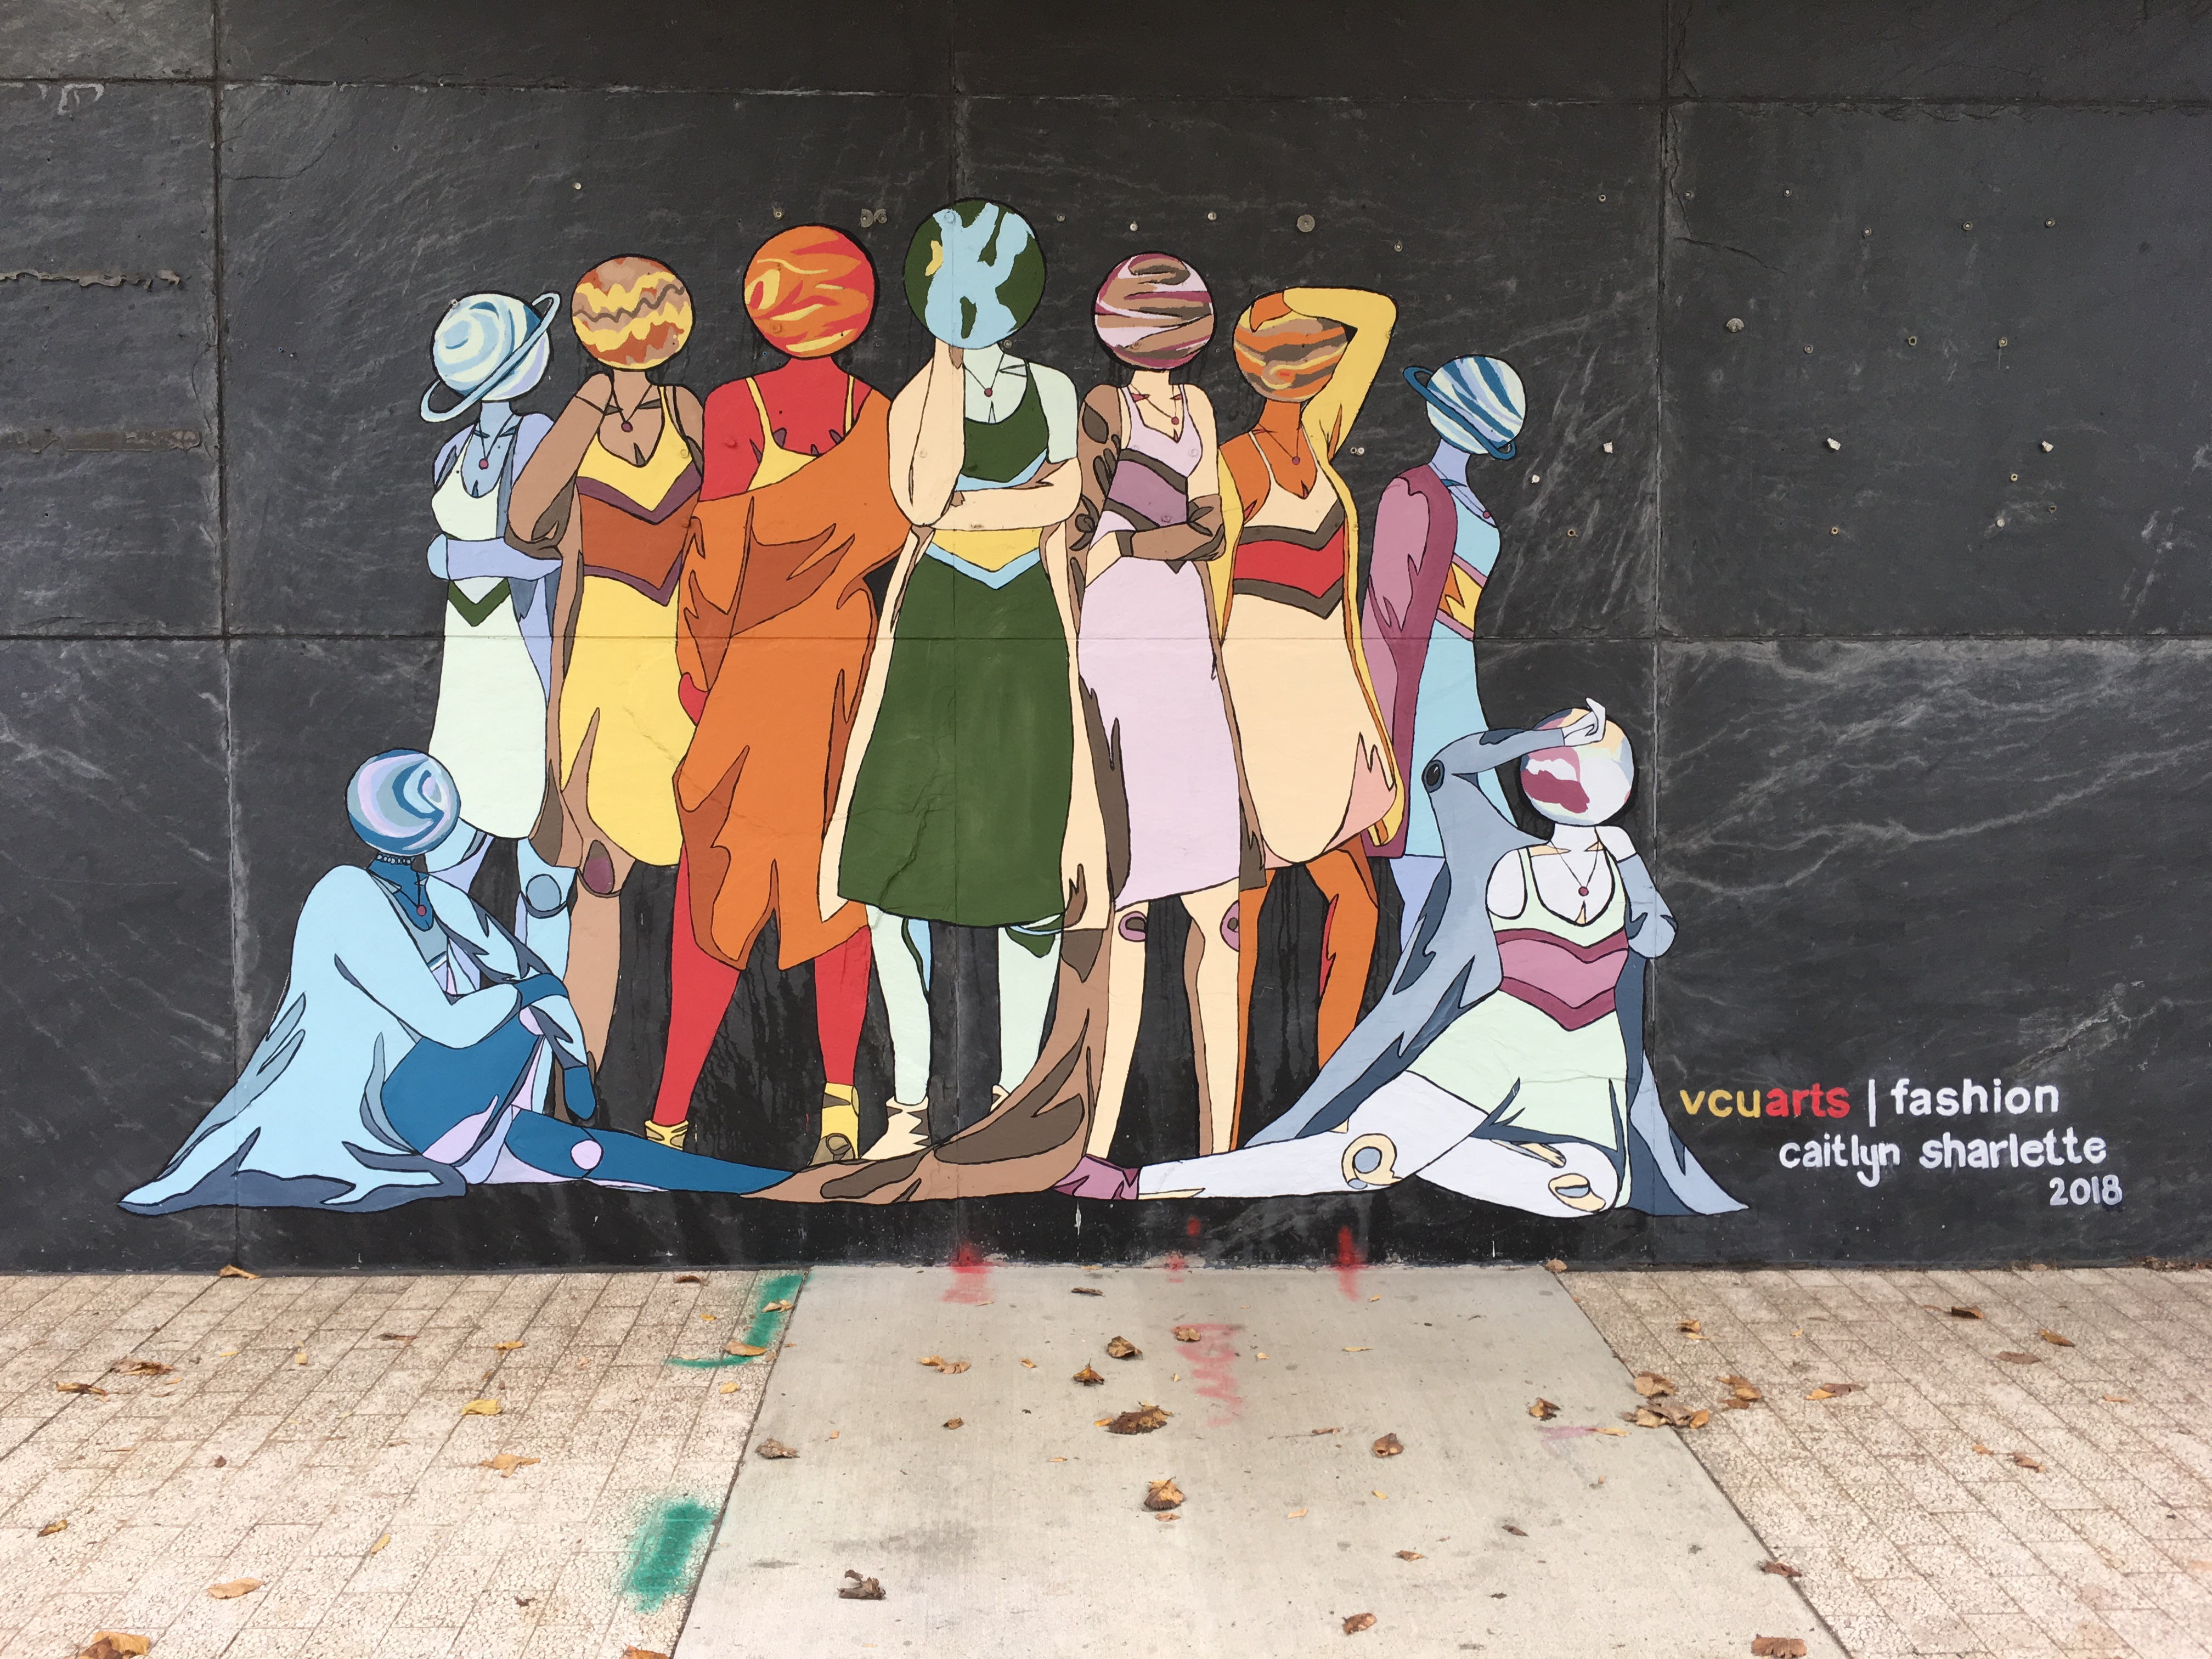
Outreach & hiring
Mural @ VCUPD headquarters
Currently hiring recruits for the next police academy
LEAP staff keeps candidates @ VCU

Slide 9
Questions & Feedback
Interim Chief Mike O’Berry
Email: hmoberry@vcu.edu
Cell: (804) 641-2386

